Slide 1
Cyclistic Case Study
By: Alfred Abraham

Slide 2
Introduction
Cyclistic is a bike-share program that has more than 5800 bicycles and 600 docking stations in Chicago
The company offers its customers three biking products: electric bikes, classic bikes, and docked bikes
The customer base for Cyclistic can be separated into two categories: Casual Riders and Members
Casual riders: Customers who only utilize Cyclistic’s single-ride or full-day passes
Members: Customers who purchase annual memberships
Cyclistic has begun to focus on converting Casual Riders into Members
Financial analyses show that Members are the more profitable customer segment

Slide 3
Business Task
Essential Question:
How do members and casual riders uses Cyclistic bikes differently and what can be done to convert casual riders into members?
Key Stakeholders:
Cyclistic marketing team
Business Task:
Collect data on how Members and Casual Riders use the bikes and develop a strategy to covert Casual Riders into Members based on the findings.

Slide 4
Steps for Collecting Data and Analysis
Use RStudio to upload and combine 12 months of data on bike trips.
Create a graph on RStudio that displays the number of bike trips each month for both casual riders and annual members.
Create a graph on RStudio that displays the total number of bike trips by bike type (electric, classic, and docked) for both casual riders and annual members.
Analyze the collected data and offer recommendations for how to convert casual riders into annual members based on it.

Slide 5
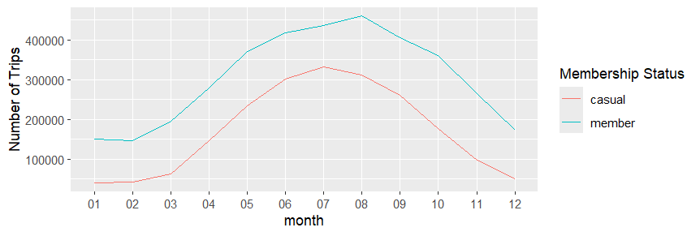
Results and Analysis Part 1
Members make more bike trips every month than Casual Riders. However, the number of bike trips peak during the summer months for both categories of users (August or month 8 for Members, July or month 7 for Casual Riders) and is a minimum during the winter months.

Slide 6
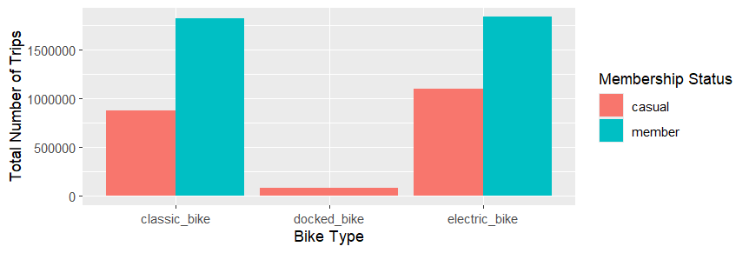
Results and Analysis Part 2
As far as total number of trips are concerned, Members outnumber Casual Riders for both classic bikes and electric bikes. However, there no reported docked bike trip for Members while for Casual Riders, there are.

Slide 7
Conclusion
There is a significant difference between how Casual Riders and Members use Cyclistic bikes.
Members make more bike trips every month than casual riders.
Casual Riders use docked bikes while members don’t.
There is one similarity between Casual Riders and Members though: the number of bike trips every month for both categories peaks in the summer and drops drastically in the winter.
Since Casual Riders use bikes much more during the summer than in the winter just like Members do, they would save a significant amount of money by switching to annual membership.

Slide 8
Top Three Recommendations
Use social media and TV ads to explain to casual riders the financial benefit of switching to an annual membership (paying less money at one time than what would be required to pay for all the needed single rides or daily passes).
To increase bike customer usage during the winter period, offer a one-time discount of 40% on the annual membership fee from August 1st to September 30th.
Offer a one-time 20% discount for the annual membership fee to any casual rider who has used Cyclistic bike services at least once in the previous three months.

Slide 9
Data Sources Used
202301-divvy-tripdata.zip
202302-divvy-tripdata.zip
202303-divvy-tripdata.zip
202304-divvy-tripdata.zip
202305-divvy-tripdata.zip
202306-divvy-tripdata.zip
202307-divvy-tripdata.zip
202308-divvy-tripdata.zip
202309-divvy-tripdata.zip
202310-divvy-tripdata.zip
202311-divvy-tripdata.zip
202312-divvy-tripdata.zip

